Slide 1
GaN on Silicon Thermal Network Models Aug 6th 2016

Slide 2
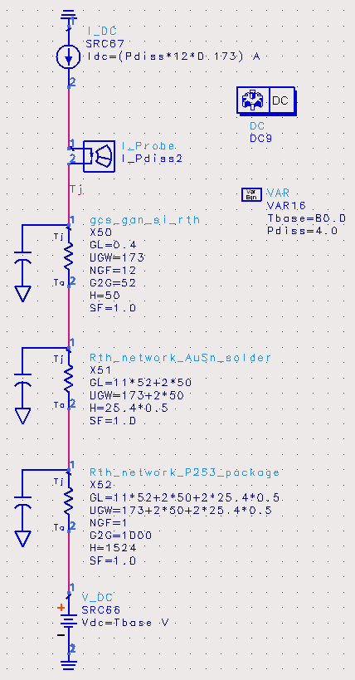
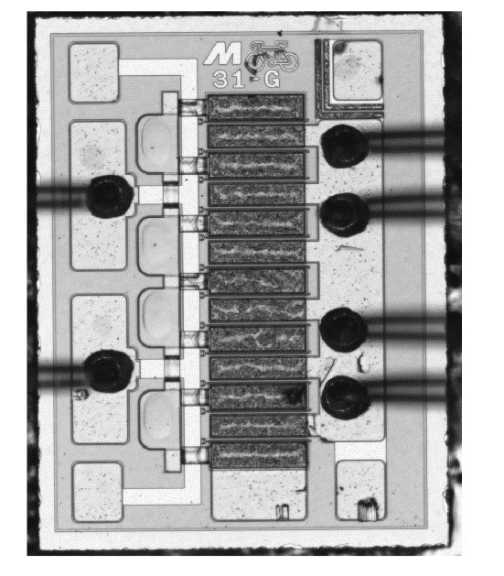
GaN on Silicon HEMT Thermal Simulation (in ADS)
12 x 173μm GaN on Si HEMT (50μm thick)
52μm G2G pitch

Slide 3
GaN on Silicon HEMT Thermal Simulation (in ADS)
HEMT total dissipated power (Watts)
thermal-electrical analog is current (Amps)
thermal resistance of GaN on Si (ºC/Watt)
die 12x173μm 50μm thick
thermal-electrical analog is resistance (Ω)
thermal resistance of AuSn
solder die attach (ºC/Watt)
thermal-electrical analog is resistance (Ω)
thermal resistance of P253
package (ºC/Watt)
thermal-electrical analog is resistance (Ω)
baseplate temperature (ºC)
thermal-electrical analog is voltage (volts)

Slide 4
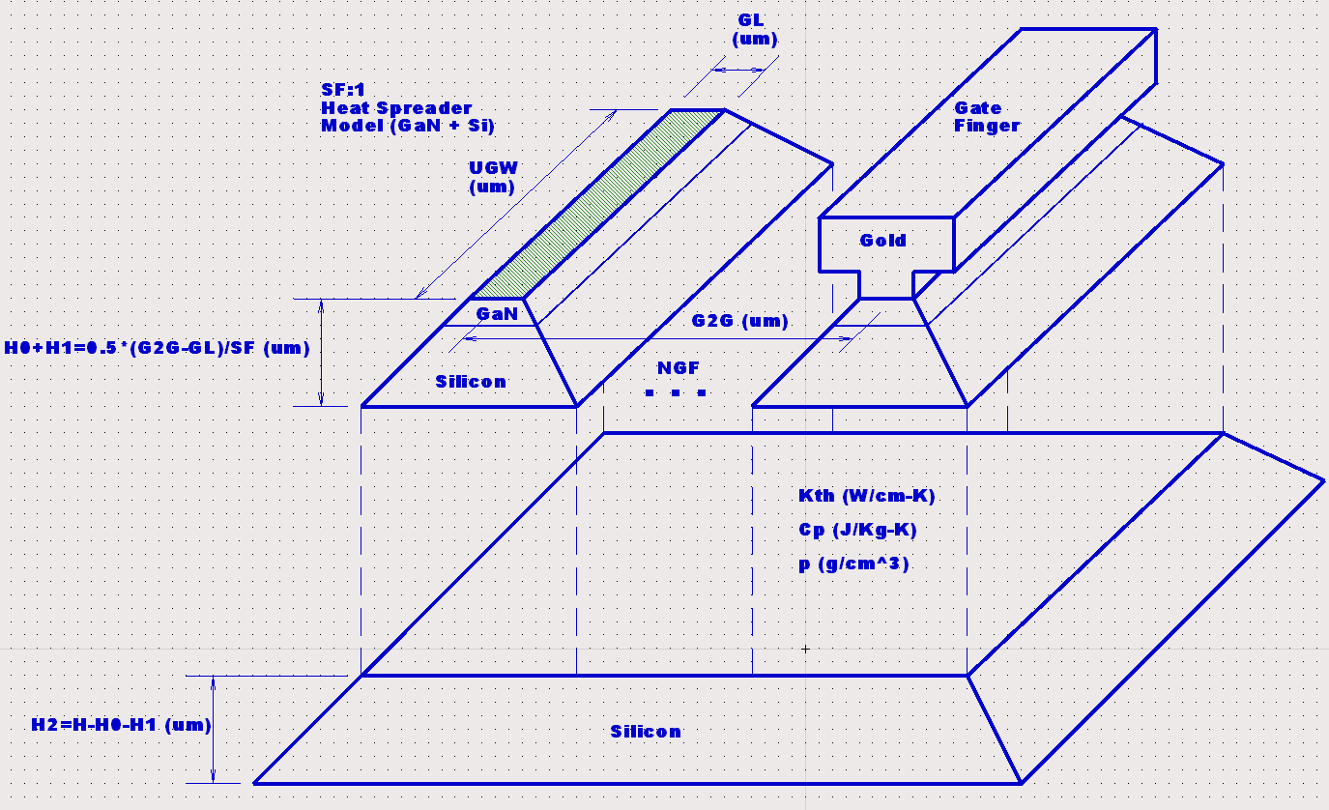
GaN on Silicon HEMT Thermal Network Model Concept
multi-finger heat spreader model

Slide 5
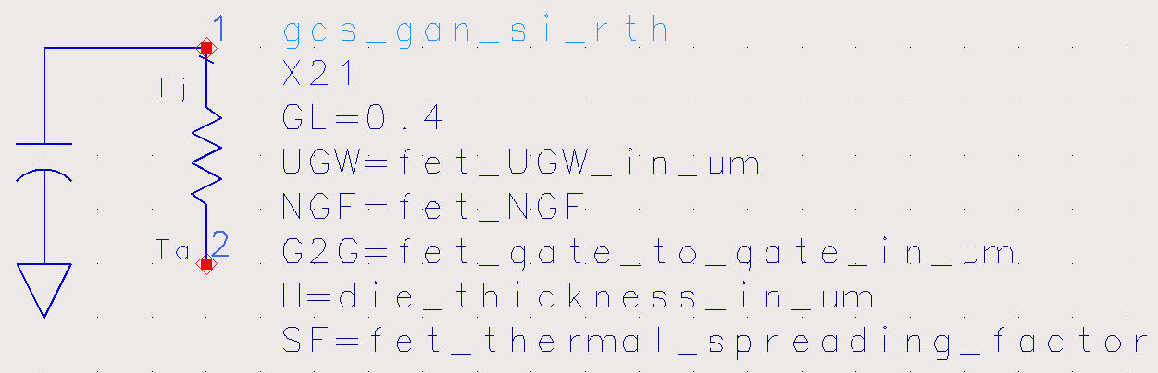
GaN on Silicon Thermal Network Model
ADS Model
length of channel heat source
0.4μm for our GaN on Si
technology

Slide 6
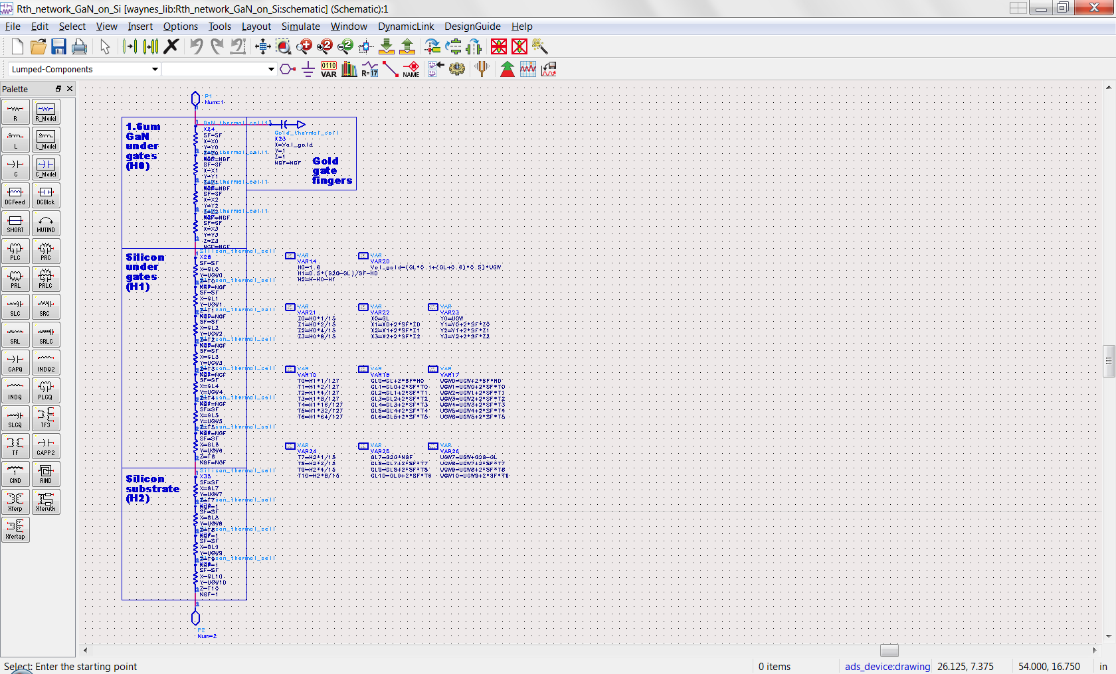
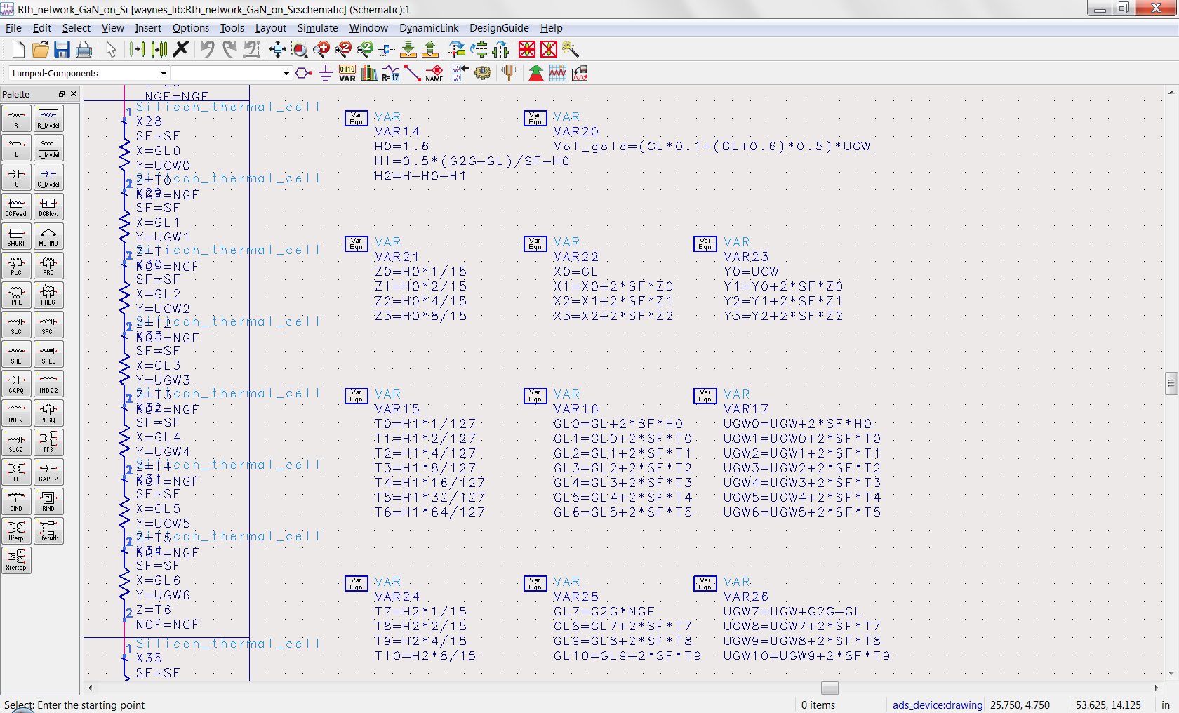
GaN on Silicon Thermal Network Model
ADS “SDD” Model

Slide 7
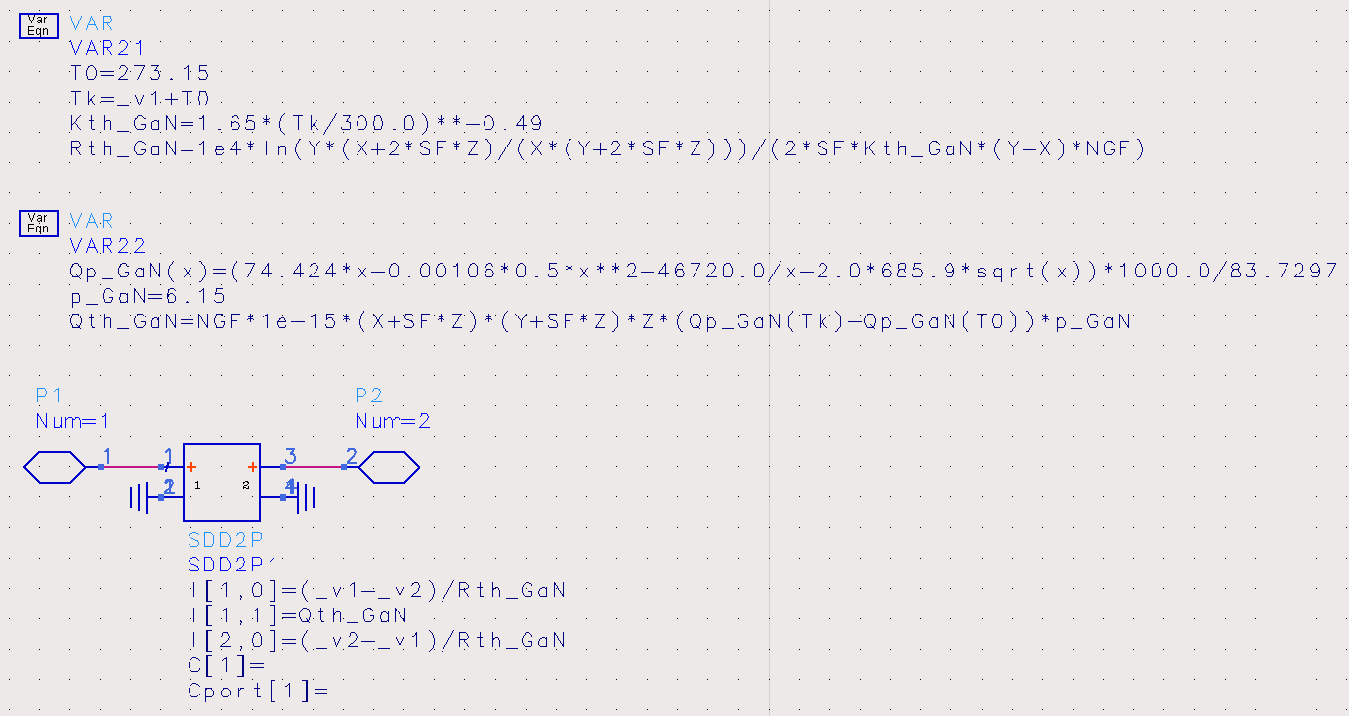
GaN Thermal Cell Model
ADS “SDD” Model

Slide 8
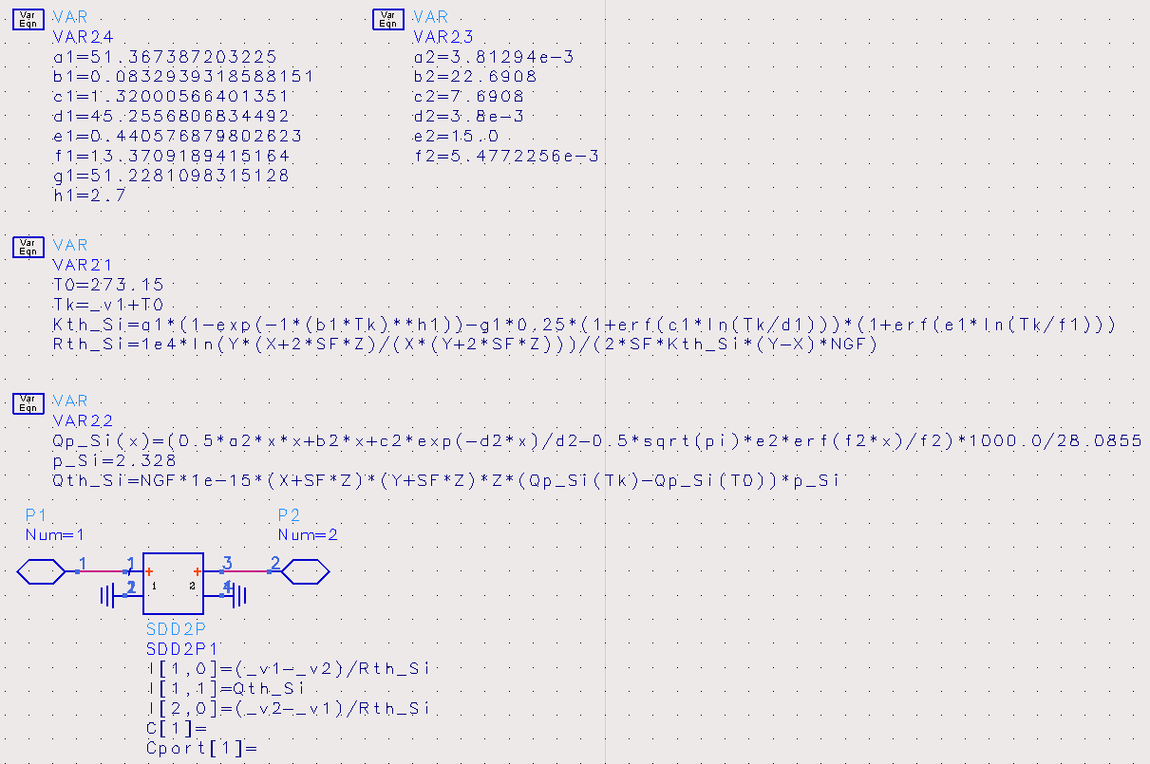
Silicon Thermal Cell Model
ADS “SDD” Model

Slide 9
Silicon Thermal Cell Model (fit versus NIST Data)
Thermal Conductivity of Silicon
Specific Heat Capacity of Silicon

Slide 10
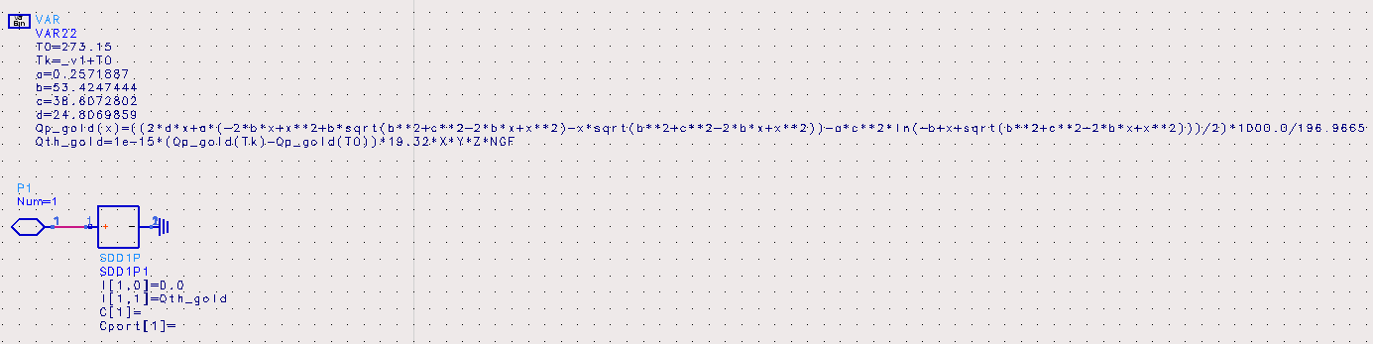
Gold Thermal Cell Model (specific heat capacity only)
ADS “SDD” Model

Slide 11
Gold Thermal Cell Model (fit versus NIST Data)

Slide 12
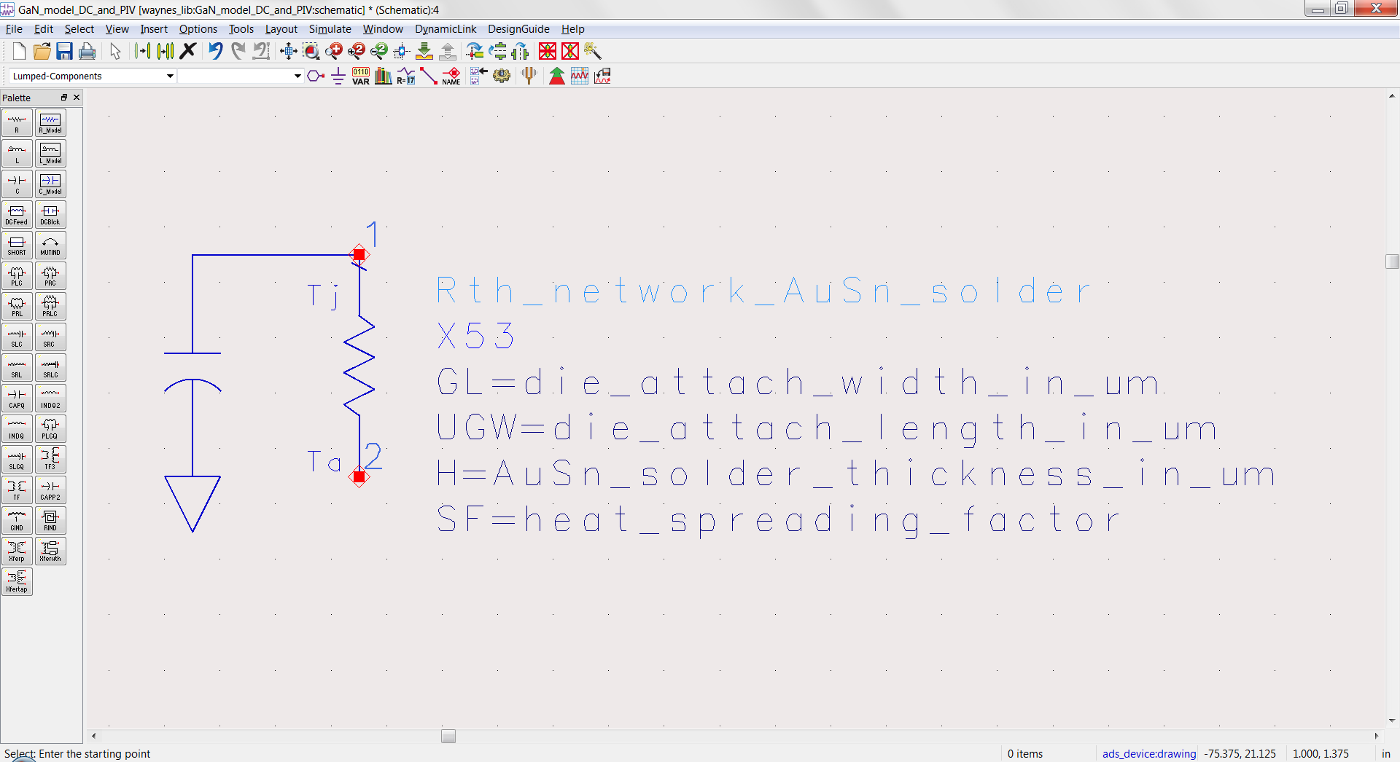
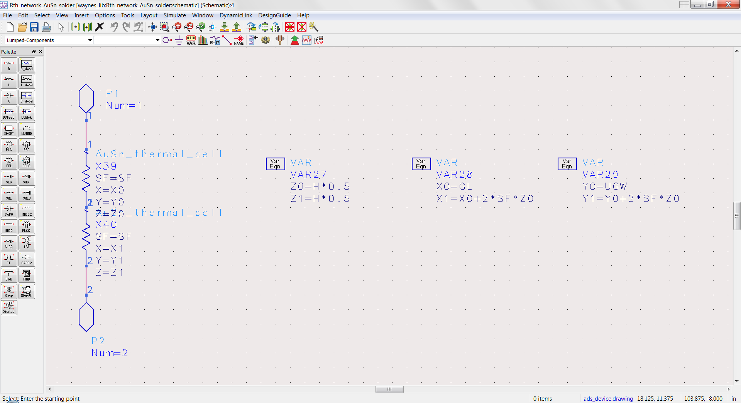
AuSn Solder Thermal Network Model
ADS Model

Slide 13
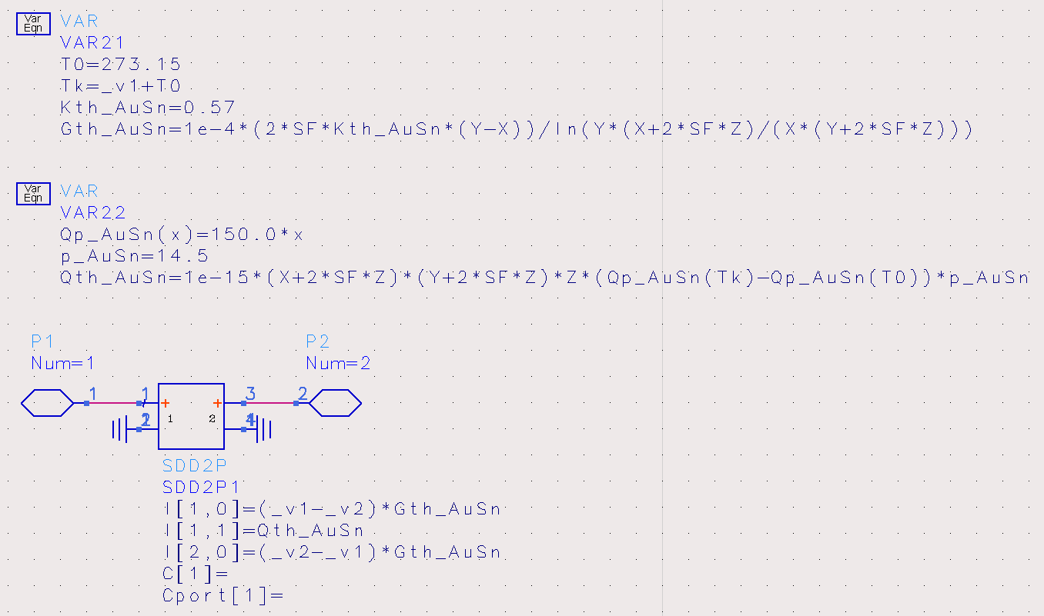
AuSn Solder Thermal Cell Model
ADS “SDD” Model
fixed vs temp Kth = 57 W/m-ºK
fixed vs temp Cth

Slide 14
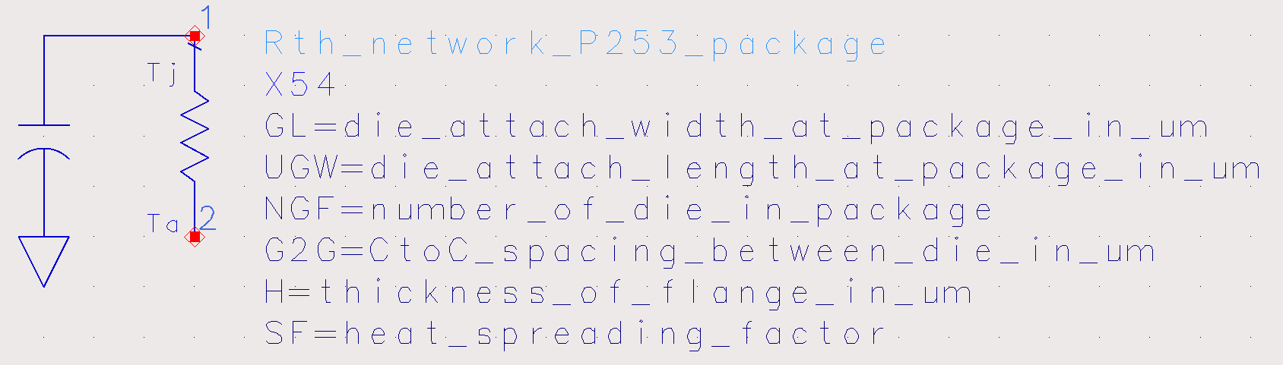
P253 Package Thermal Network Model

Slide 15
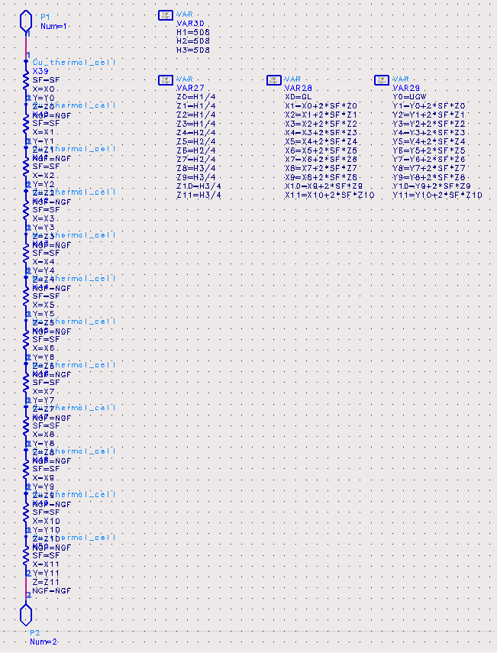
P253 Package Thermal Network Model
ADS Model
Copper
508μm
Moly
508μm
Copper
508μm

Slide 16
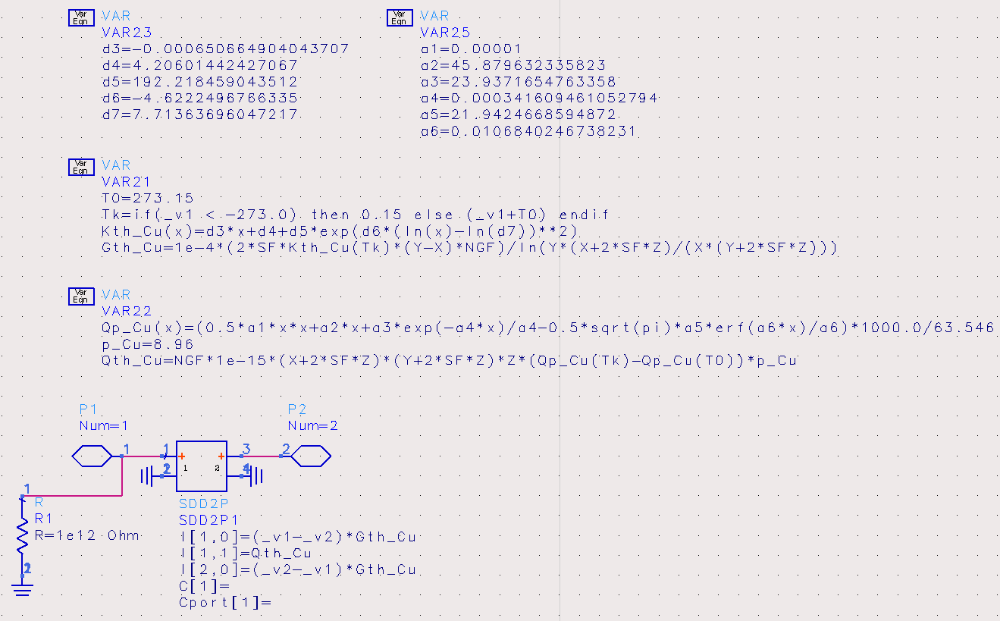
Copper Thermal Cell Model
ADS “SDD” Model

Slide 17
Copper Thermal Cell Model (fit versus NIST Data)
Thermal Conductivity of Copper
Specific Heat Capacity of Copper

Slide 18
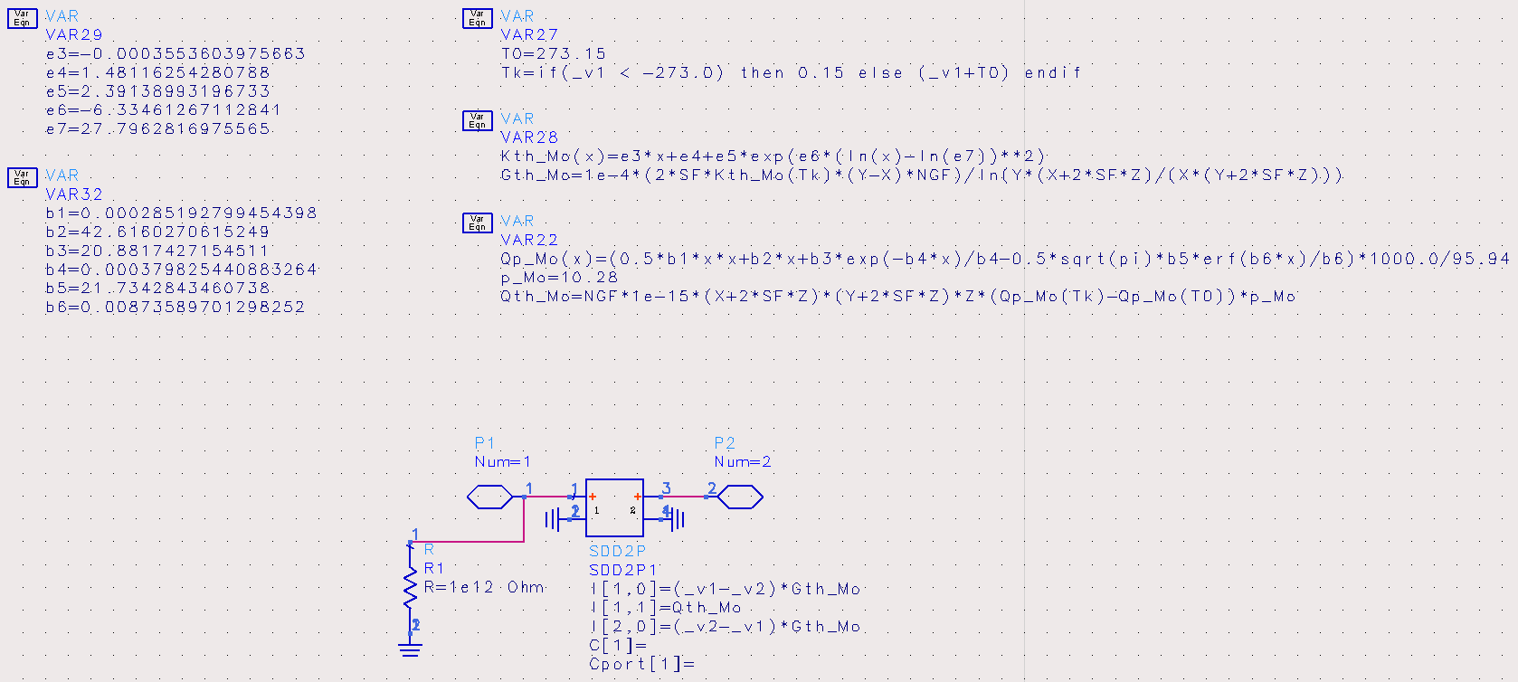
Moly Thermal Cell Model
ADS “SDD” Model

Slide 19
Moly Thermal Cell Model (fit versus NIST Data)
Thermal Conductivity of Moly
Specific Heat Capacity of Moly

Slide 20
GaN on Silicon HEMT Thermal Simulation (in ADS)
12 x 173μm GaN on Si HEMT (50μm thick)
52μm G2G pitch

Slide 21
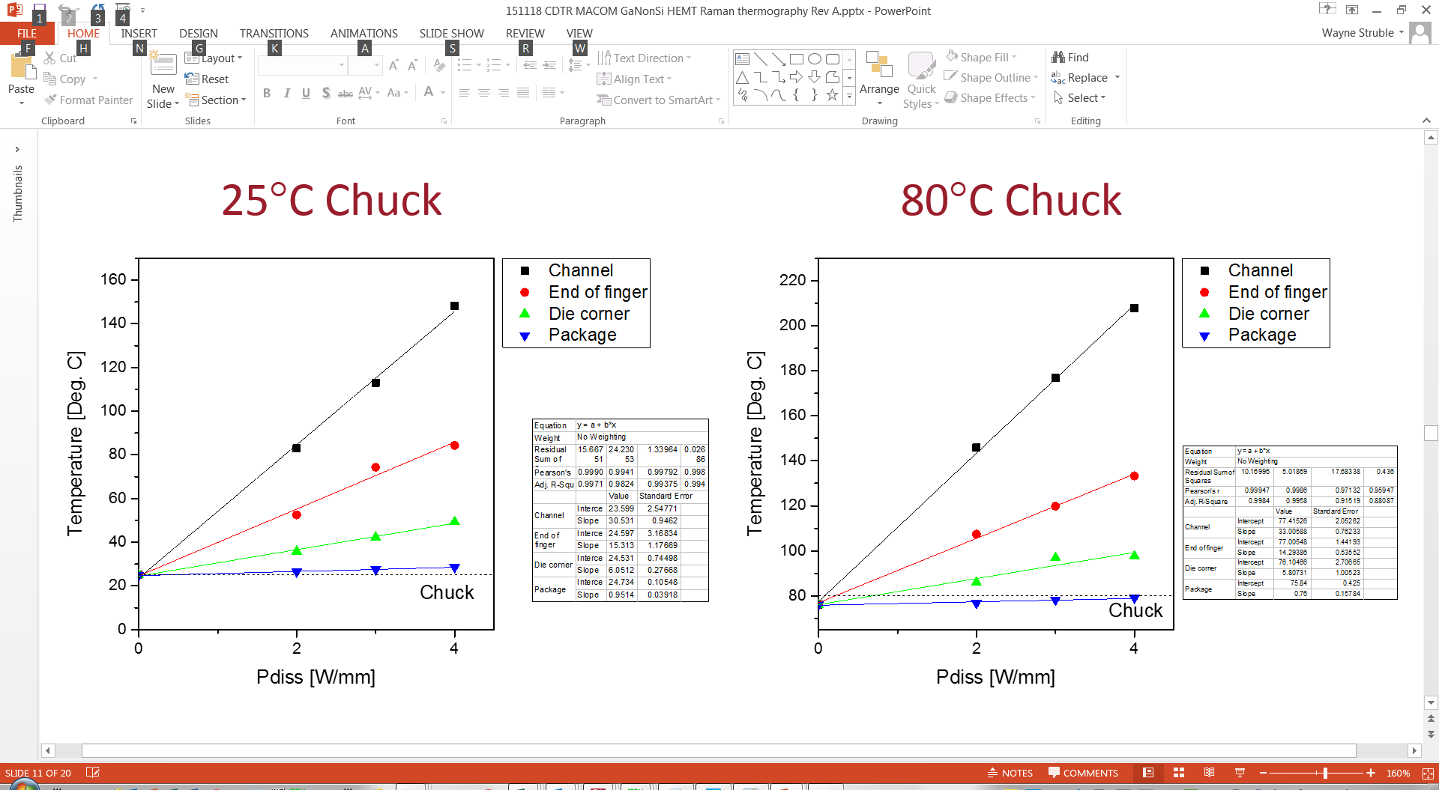
GaN on Silicon HEMT Thermal Simulation (in ADS)
Micro Raman Measurements
from University of Bristol
ADS Simulation
25ºC Baseplate

Slide 22
GaN on Silicon HEMT Thermal Simulation (in ADS)
Micro Raman Measurements
from University of Bristol
ADS Simulation
80ºC Baseplate

Slide 23
GaN on Silicon HEMT Thermal Simulation (in ADS)
Belfast Thermal Transient
Measurement
ADS Thermal Transient
Simulation (with AC360 Package)

Slide 24
Gate resistance thermometry WN057 0.45 µm GaN-Si
Contact: bryan.schwitter@macom.com

Slide 25
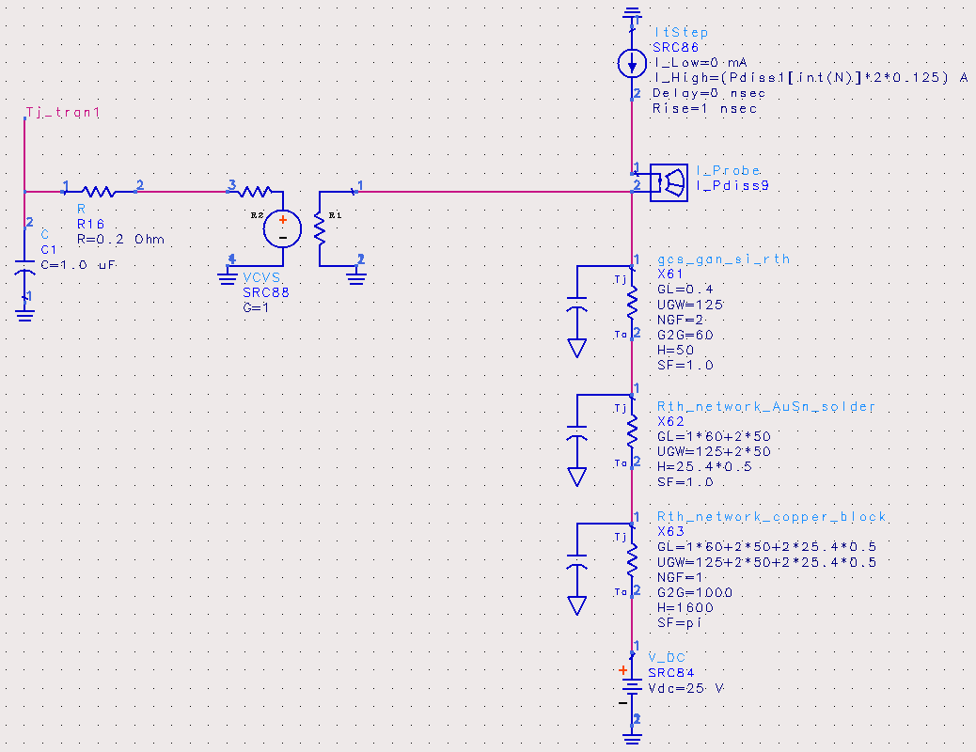
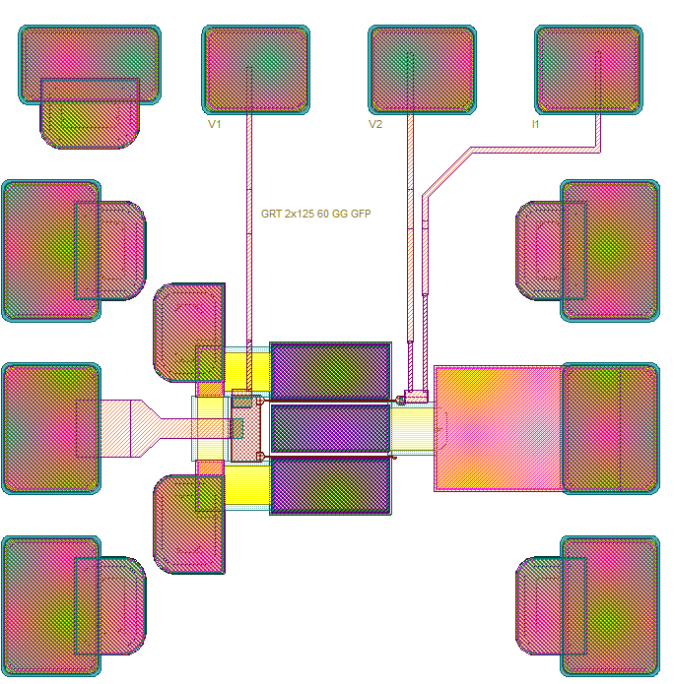
Transient GRT 2x125 µm, T_{a} = 25 °C
GaN on Si Thermal Model

Slide 26

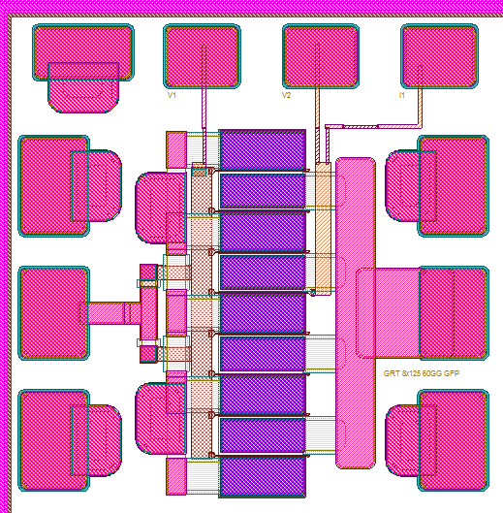
Transient GRT 8x125 µm, T_{a} = 85 °C
GaN on Si Thermal Model

Slide 27
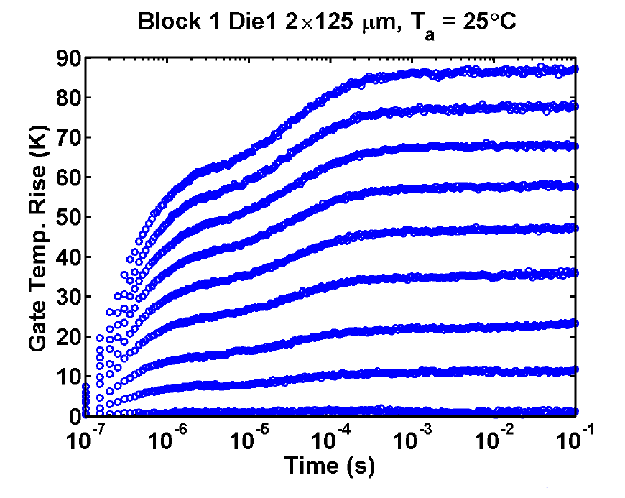
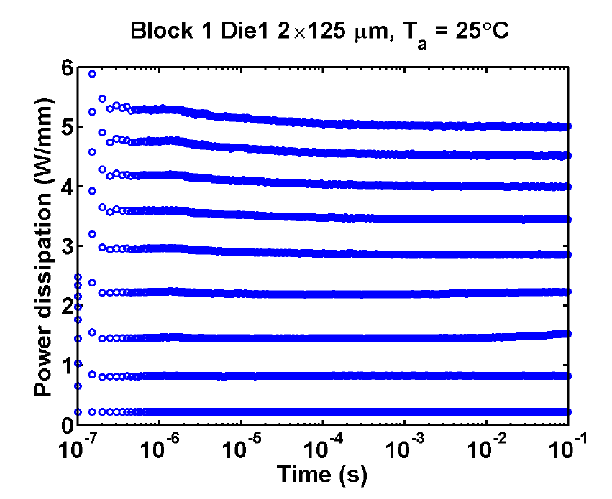
Transient GRT 2x125 µm, T_{a} = 25 °C
GaN on Si Thermal Model
Gate temperature vs. time and corresponding channel power dissipations

Slide 28
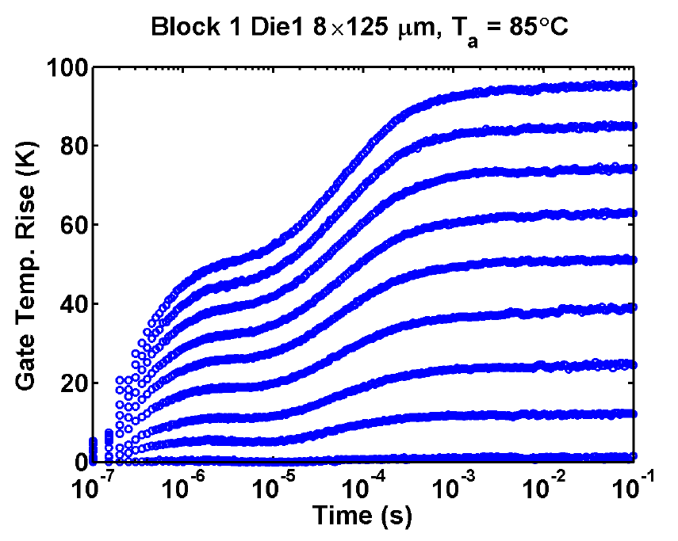
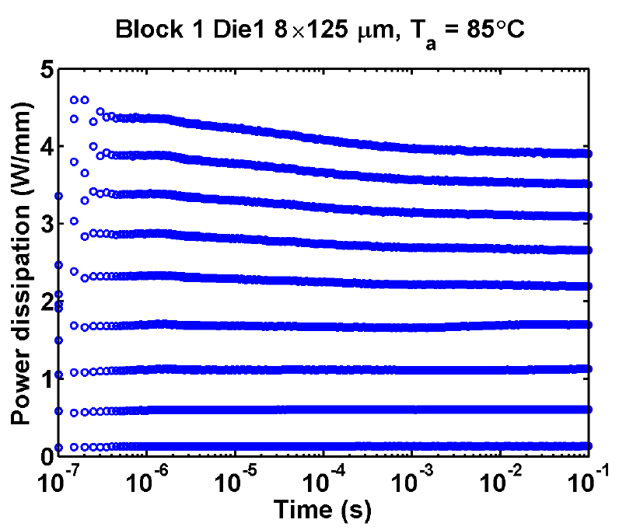
Transient GRT 8x125 µm, T_{a} = 85 °C
GaN on Si Thermal Model
Gate temperature vs. time and corresponding channel power dissipations

